Slide 1

Impact of Immigration and Unemployment on Housing Prices: An Economic Analysis
Muhammad Haziq

Slide 2
Table of content
Executive summary
Introduction
Methodology
Housing data
Unemployment and labour data
Housing, unemployment and immigration yearly performance
Interactive dashboard
Discussion
Conclusion
References

Slide 3
Executive summary
The summary provides an overview of the analysis of the unemployment rate, immigration trend, and house prices.
High unemployment can reduce demand for houses, as fewer people can afford to buy a home. The influx of immigrants can lead to increased demands for housing. More people needing homes can drive up prices, especially where housing supplies are limited.
The analysis aims to study the relationship between unemployment rates, immigration, and house prices, as well as to analyze current trends.
Our analysis reveals that house prices and the unemployment rate are negatively correlated. While immigration and house prices have a slight negative correlation, as immigration rates increase, it does not necessarily mean that house prices increase rapidly.
Higher unemployment rates lead to lower house prices, while the rise in immigration can increase housing demand, potentially having only a minimal impact on house prices.

Slide 4
Introduction
High levels of unemployment can reduce the demand for houses, as fewer individuals have the financial means to purchase a home. Conversely, an influx of immigrants can generate an increase in demand for housing, potentially driving up prices, particularly in areas with limited housing supplies.
The purpose of this report is to assess whether the unemployment rate and immigration trends have an impact on house prices.
This report will prioritize identifying the correlation between immigration, unemployment, and house prices, analyzing current trends, and predicting both house prices and unemployment rates.
Additionally, the report will encompass a section dedicated to data analysis and key findings.

Slide 5

Methodology

Slide 6
Methodology
Collect the relevant data sets
Data cleaning
Explanatory data analysis
Correlation Analysis
Linear regression Analysis
Interactive Dashboard

Slide 7
Housing data

Slide 8
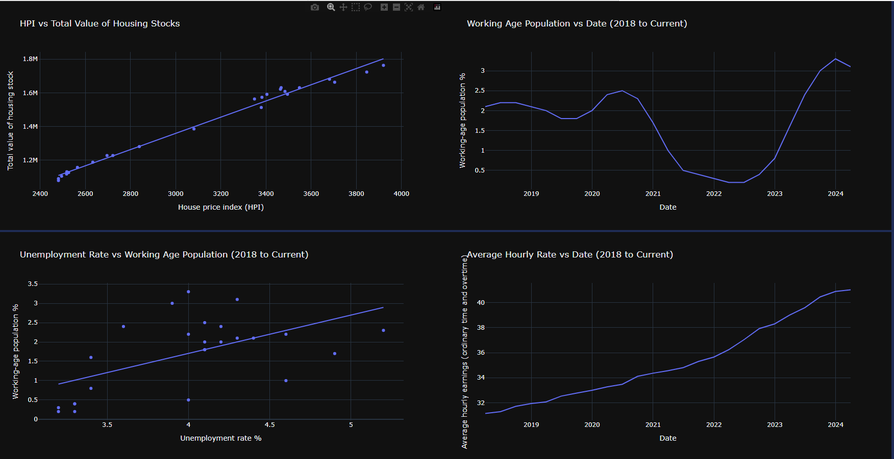
Housing and average hourly rate (Labor)

Slide 9
Key findings
HPI and total value of housing stock: A strong positive correlation exists between the House Price Index (HPI) and the total value of housing stock, indicating that as house prices rise, the overall value of housing stock also increases.
Average hourly wages: Additionally, there is a consistent upward trend in average hourly wages over time.

Slide 10
Unemployment rate and Labor data

Slide 11
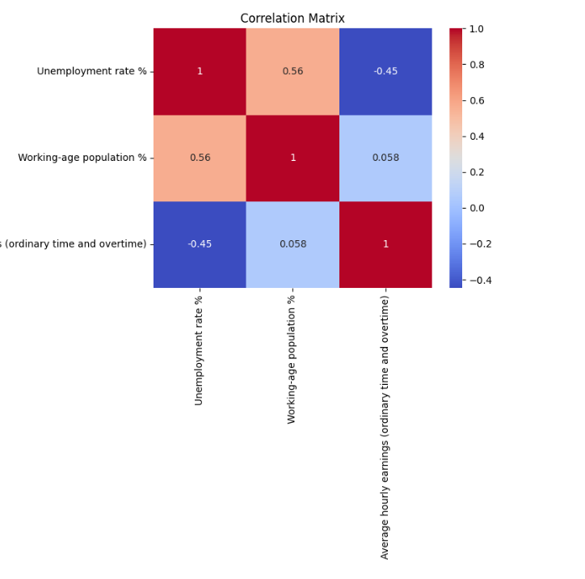
Correlation Matrix working age population, average hourly rate and unemployment

Slide 12
Key finding: Correlation Matrix
Average hourly rate and unemployment rate: The correlation between average hourly wage and unemployment rate is -0.45, indicating that higher wages are linked to lower unemployment rates
Working age population and unemployment rate: there is a correlation of 0.56 between working age population and unemployment rate, suggesting that an increase in the working age population can lead to a higher unemployment rate if job growth does not keep up.

Slide 13
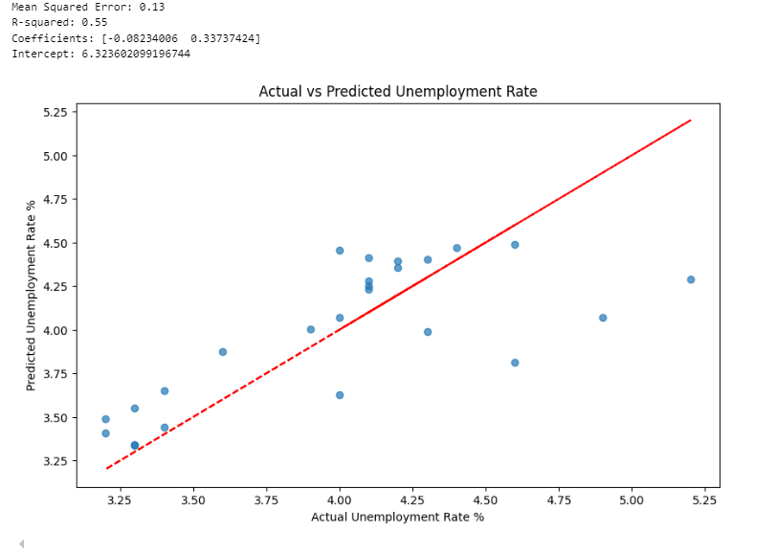
Actual vs predicted unemployment rate

Slide 14
Key findings: Predictive analysis (unemployment rate)
MSE 0.13: The predictions are off by 0.13 units from the unemployment rate.
R squared: 0.55: The model explains 55% of the variation in the unemployment rate, which indicates a decent fit.
Average hourly rate Coefficient = -0.082 Higher wages are associated with lower unemployment.
Working age Coefficient = 0.337. More working-age people are linked to higher unemployment.
Plot interpretation: The plot shows how close the predicted unemployment rate is to the actual rates. Points close to the red line make for better predictions.

Slide 15
Housing, immigration and labour data

Slide 16
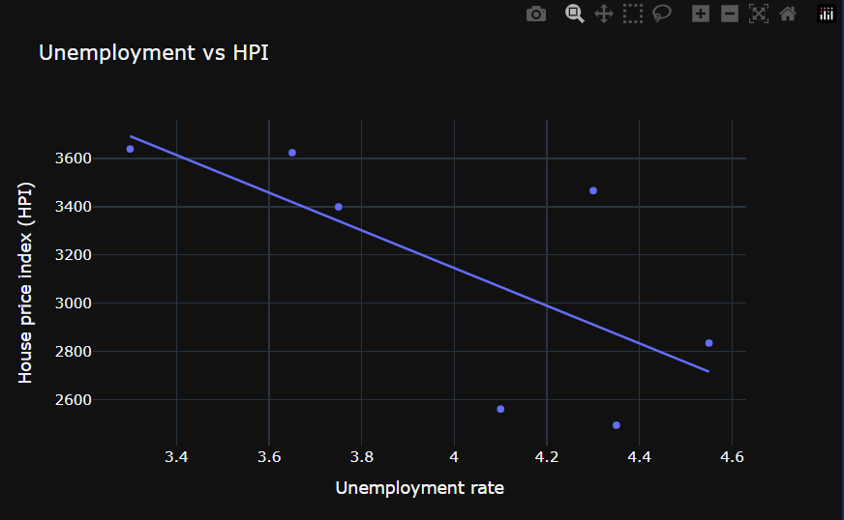
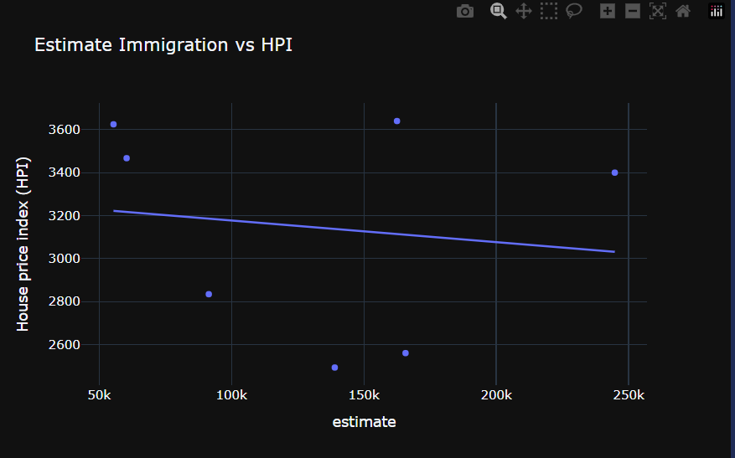
Scatter plot unemployment and immigration vs house price index

Slide 17
Key findings: House price correlation
Unemployment rate vs HPI: The unemployment rate and house prices are negatively correlated, meaning higher unemployment leads to lower house prices.
Immigration number vs HPI: Similarly, there is a slight negative correlation between immigration numbers and house prices, suggesting that increased immigration doesn't necessarily mean higher house prices due to other economic factors.

Slide 18
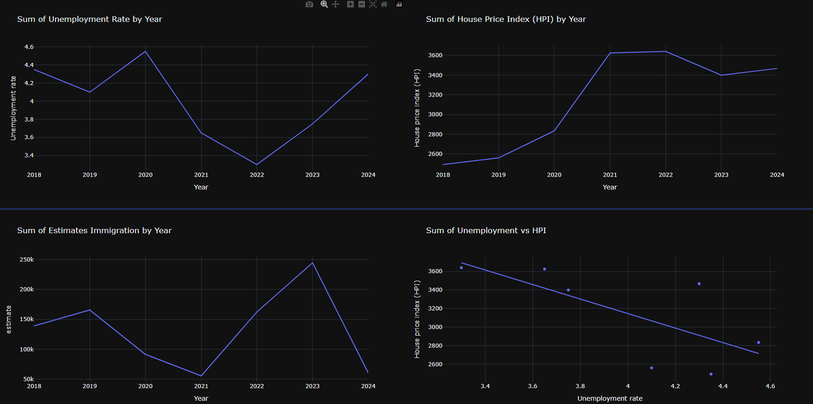
Sum of yearly unemployment rate, house price index and estimate immigration by year

Slide 19
Key findings: Sum of yearly data trend
Unemployment rate: Unemployment rate has increased in 2024, indicating potential economic challenges or labor market adjustments.
House price index (HPI): House Price Index (HPI) continues to rise, but recent fluctuations may affect housing market stability and prices.
Estimate immigration: Estimated immigration has sharply declined in 2024, potentially impacting economic growth and housing demand.

Slide 20
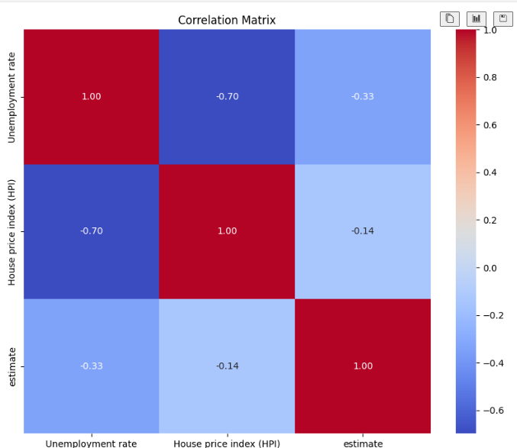
Correlation matrix between unemployment rate, HPI and immigration estimate

Slide 21
Key findings: Correlation Matrix
Unemployment and HPI: -0.70: There is a strong negative correlation between unemployment rate and house price index. If unemployment rate decrease the house price tend to increase. Indicates that strong job market may boost the housing demand and prices
Immigration vs HPI: -0.14: Immigration has minimal impact on the house price. Slight increase in immigration can increase housing demand potentially effecting the house prices
Immigration vs unemployment rate: -0.33: Higher immigration rate might be associated with low unemployment rate. Possible due to immigrant filling labour market gaps or stimulating economic growth.

Slide 22
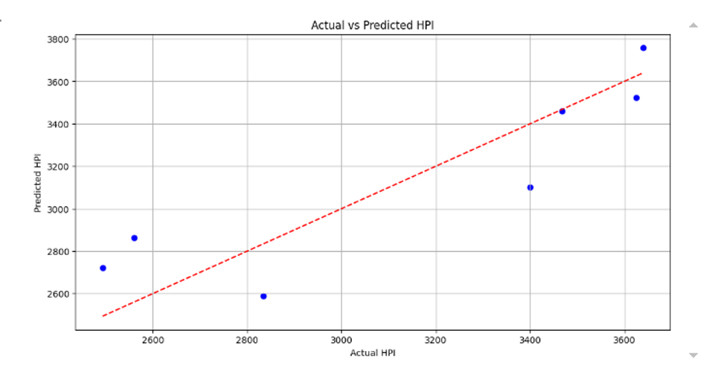
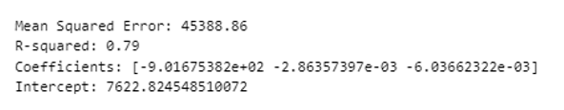
Actual vs Predicted HPI

Slide 23
Key finding: Actual vs predicted HPI
Graph: Points close to the line indicate accurate prediction, suggesting good performance but with room for improvement.
MSE (Mean Squared Error): Value = 45,388. This indicates the average squared difference between predicted house prices and indices.
R-Square: Value = 0.79. Model explains 79% of the variability in house price, indicating a strong fit.
A 1% increase in the unemployment rate decreases the house price index by about 902.81.
For each immigration, the house price index decreases by 0.000978.
Each additional house sale reduces the house price index by 0.00596.
Intercept value = 7620.14. The baseline house price index when all other variables are zero.

Slide 24
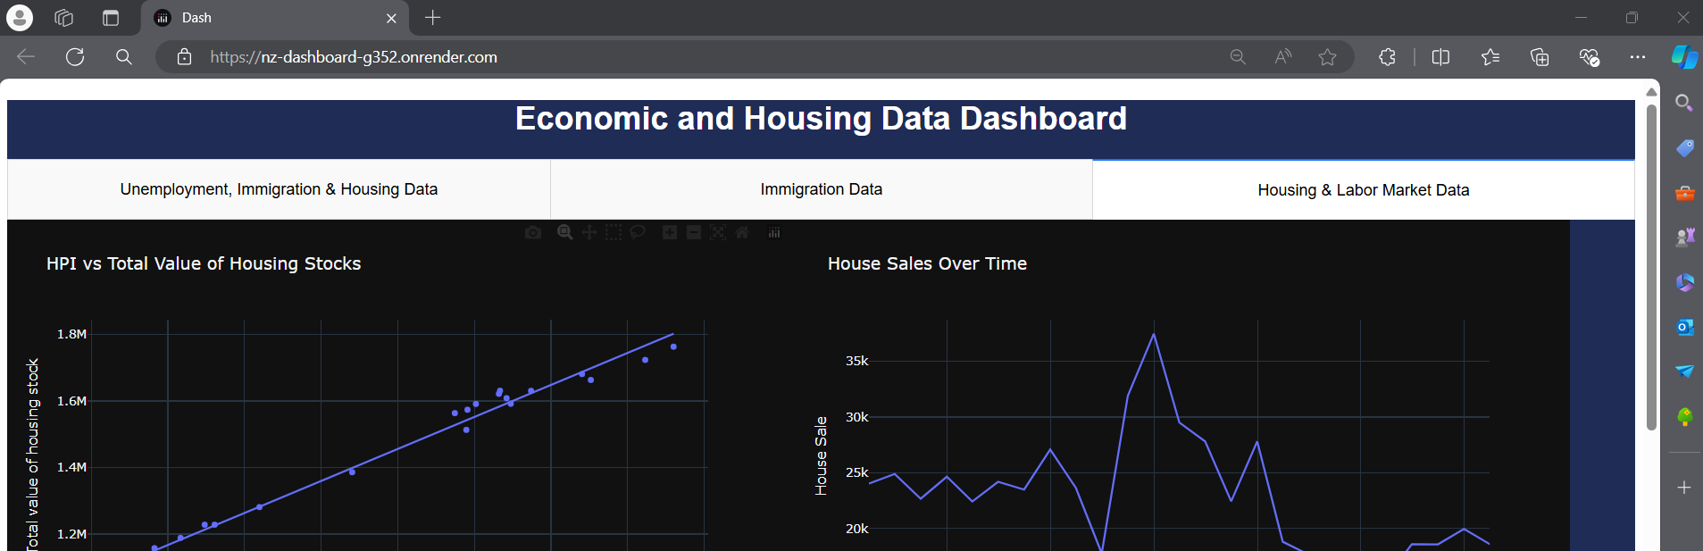
Interactive dashboard
https://nz-dashboard-g352.onrender.com/

Slide 25
Discussion
The analysis explores the impact of unemployment and immigration on the housing market.
The findings show that a strong job market boosts housing demand, while immigration has minimal impact on house prices. Additionally, higher immigration may reduce the unemployment rate.
Understanding this relationship can inform public policy and community planning for economic stability.
Further research could examine the impact of policy changes on immigration and housing, as well as the influence of interest rates on housing trends.

Slide 26
Conclusion
Higher unemployment rates generally lead to lower house prices, while rising immigration can increase housing demand but typically has only a minimal impact on house prices.
Key points to consider are that the unemployment rate has increased in 2024, indicating economic challenges or labor market adjustments. The house price index continues to rise, but recent fluctuations may affect housing market prices and stability. Immigration has sharply declined in 2024, potentially impacting housing demand. It is important to understand the significance or implication of these findings.
These trends are essential for the government in creating effective economic policies, addressing housing affordability, and planning for sustainable development. It helps to balance housing supply and demand, ensuring economic resilience.
Understanding the relationship between immigration, unemployment, and house prices is key to crafting policies that ensure a stable and prosperous housing market.

Slide 27
References

Slide 28


Data sources
Reserve Bank of New Zealand. (n.d.). Housing market: Housing (M10). Retrieved from https://www.rbnz.govt.nz
Stats NZ. (n.d.). Renting price index: CSV files for download. Retrieved from https://www.stats.govt.nz
Stats NZ. (n.d.). Immigration country data: CSV files for download. Retrieved from https://www.stats.govt.nz
Stats NZ. (n.d.). Immigration by gender and age: CSV files for download. Retrieved from https://www.stats.govt.nz
Reserve Bank of New Zealand. (n.d.). Labour market: Labour market (M9). Retrieved from https://www.rbnz.govt.nz

Slide 29

GitHub Data and Analysis Code
https://github.com/HAZCHEM234/NZ_Immigration_House_price_and_unemployment_rate.git

